Slide 1
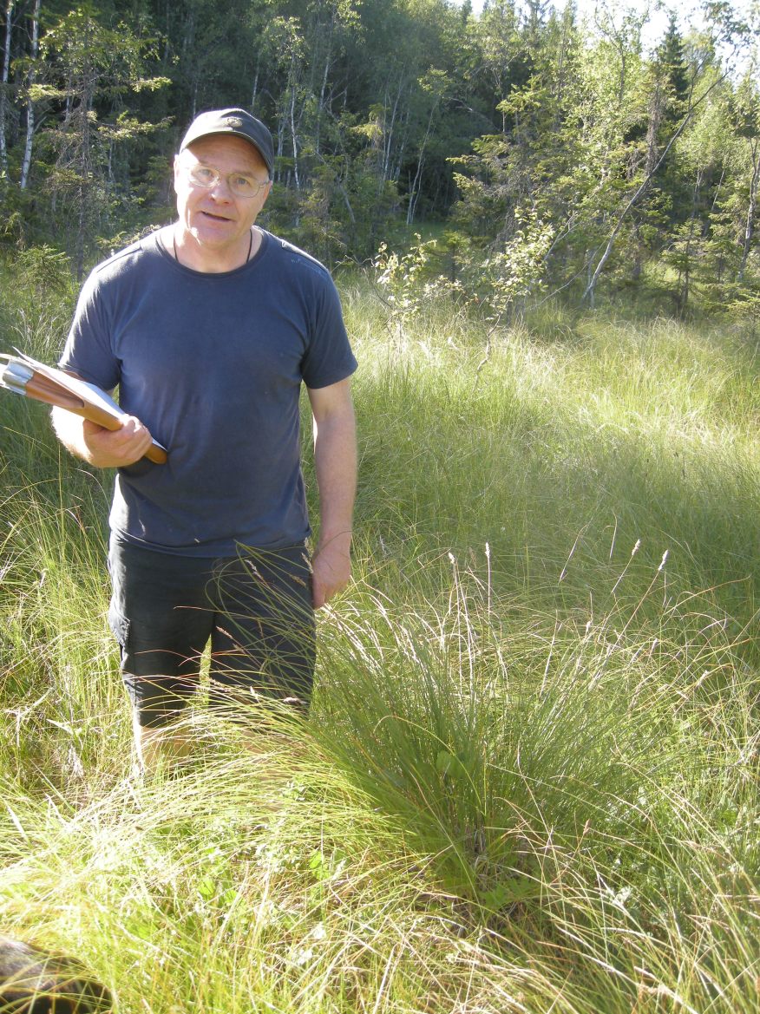
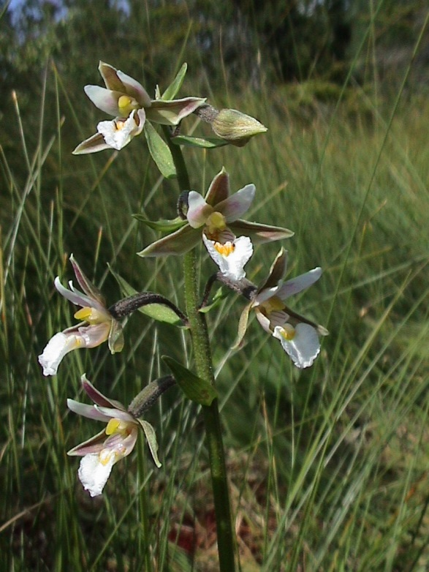
Vegetation changes after 17 years of restoration of a hay‐making mire
Seminar in honour of Asbjørn Moen
Trondheim
2014 02 25
Rune Halvorsen
& Tor Øystein Olsen
Foto: Arild Andresen

Slide 2
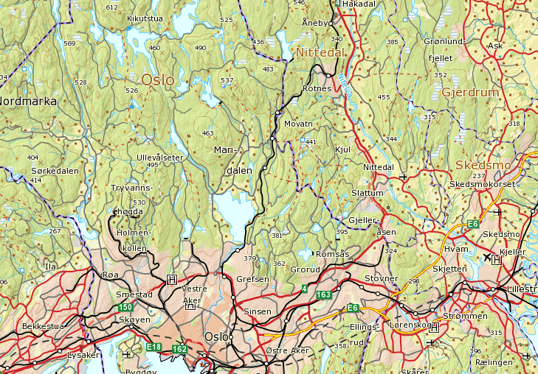
Slåttemyra – a brief presentation
  Nittedal municipality, Akershus county
  Ca. 15 km NE of Oslo city centre
  South boreal vegetation zone, 260 m asl
  Weakly oceanic vegetation section
  annual precipitation: 900–1000 mm
  annual temperature: 3.5 °C
5 km

Slide 3
Conservation history
‘Discovered’ in 1970 by Asbjørn Moen (AM) during work with county-wise mire conservation plans
AM spotted Slåttemyra as a mire of potential scientific interest because of
  its name
  ‘promising geology’; situated in the transition between patches of rhomb-porphyry and basaltic rocks
Visited by AM 1970 08 31 who described it as a former hay-making fen
Protected as Nature reserve in 1981
Re-visited 1996 by AM & Tor Øystein Olsen (TØO); report 1997
Management plan elaborated 1996–97
Onset of restoration: 1997

Slide 4
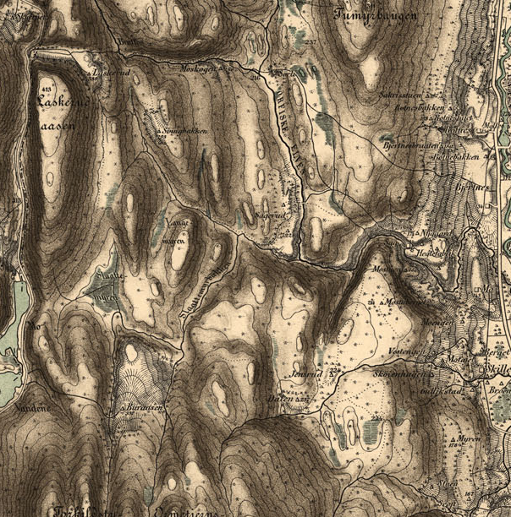
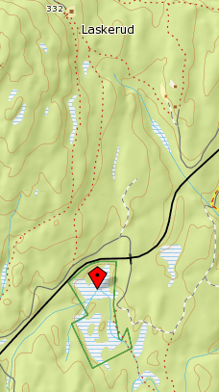
History of use
  1887 map
    Slaattemyren
    Slaattemyrbækken
  Laskerud (farm)
    Slåttemyra was used for hay-making till the 1930s
    Last time harvested during World War II
    Used for hay-making in years with low crop yields, less often than every 2nd year
    Sporadically grazed by cattle
1.5 km

Slide 5
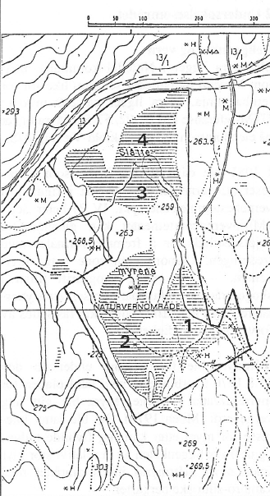
The mire
  Divided into three, not fully separated parts
  Very gently to distinctly sloping fens
  Mostly ’intermediate’ to ’rich’ fen expanse vegetation
  Some parts influenced by springs, some parts with mire-margin character

Slide 6
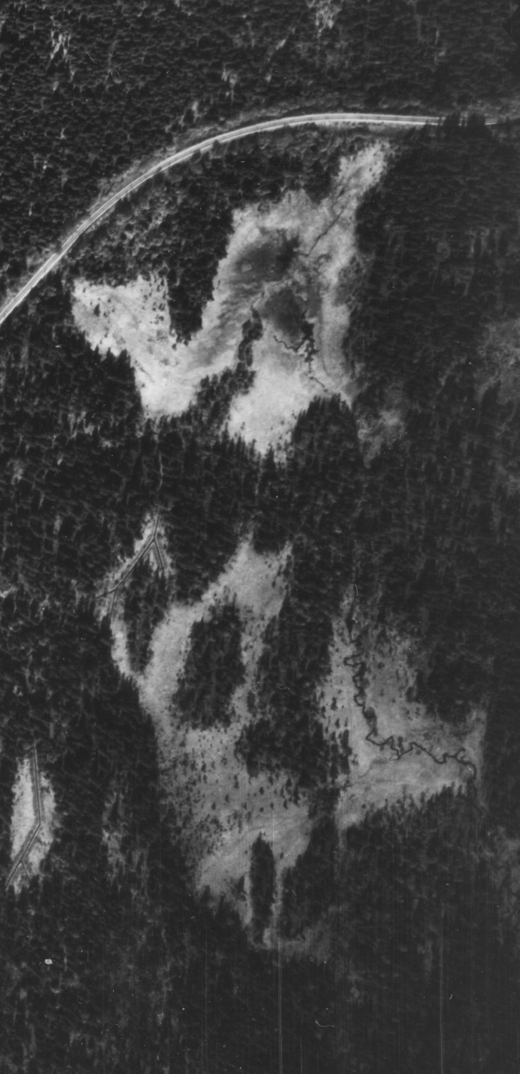
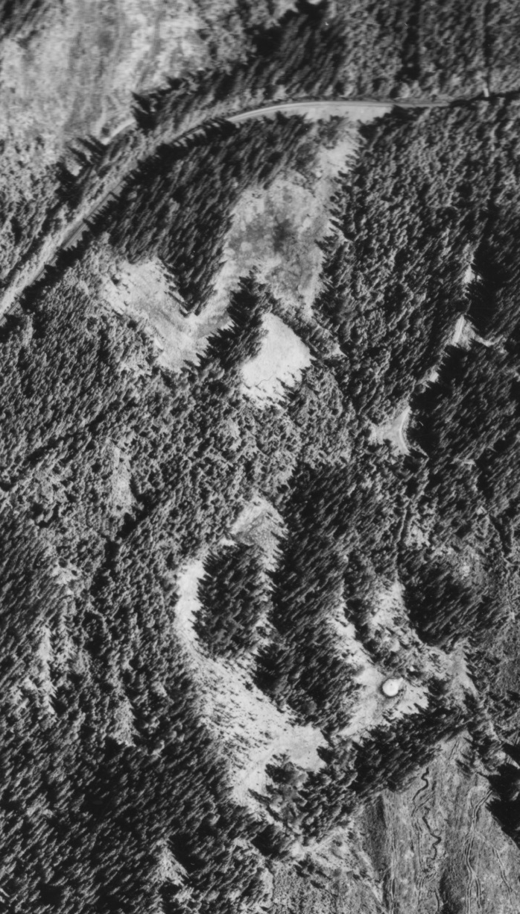
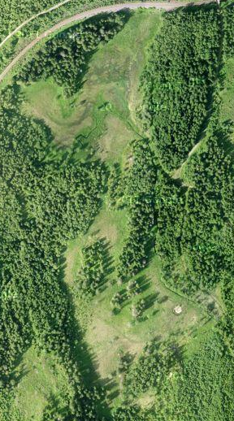
Man-made change and re-growth patterns
1937
1990
2010

Slide 7
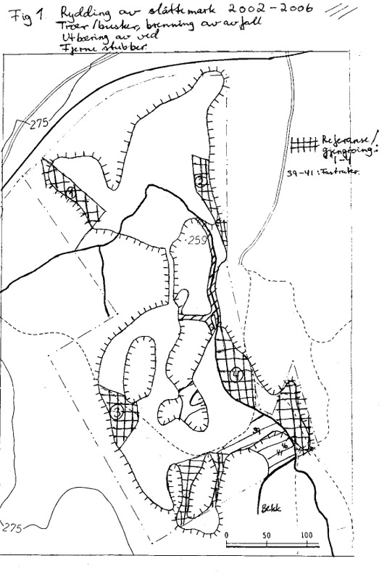
Management plan
  The 1996–97 management plan by AM & TØO was approved by the environmental management authorities (Fylkesmannen i Oslo og Akershus, Miljøvern-avdelingen)
  TØO started an ambitious effort to restore Slåttemyra as a hay-making mire landscape in 1997
    removal of trees and shrubs near mire margins
    hay-making, mostly every second year
    small parts of the mire were left as reference areas

Slide 8
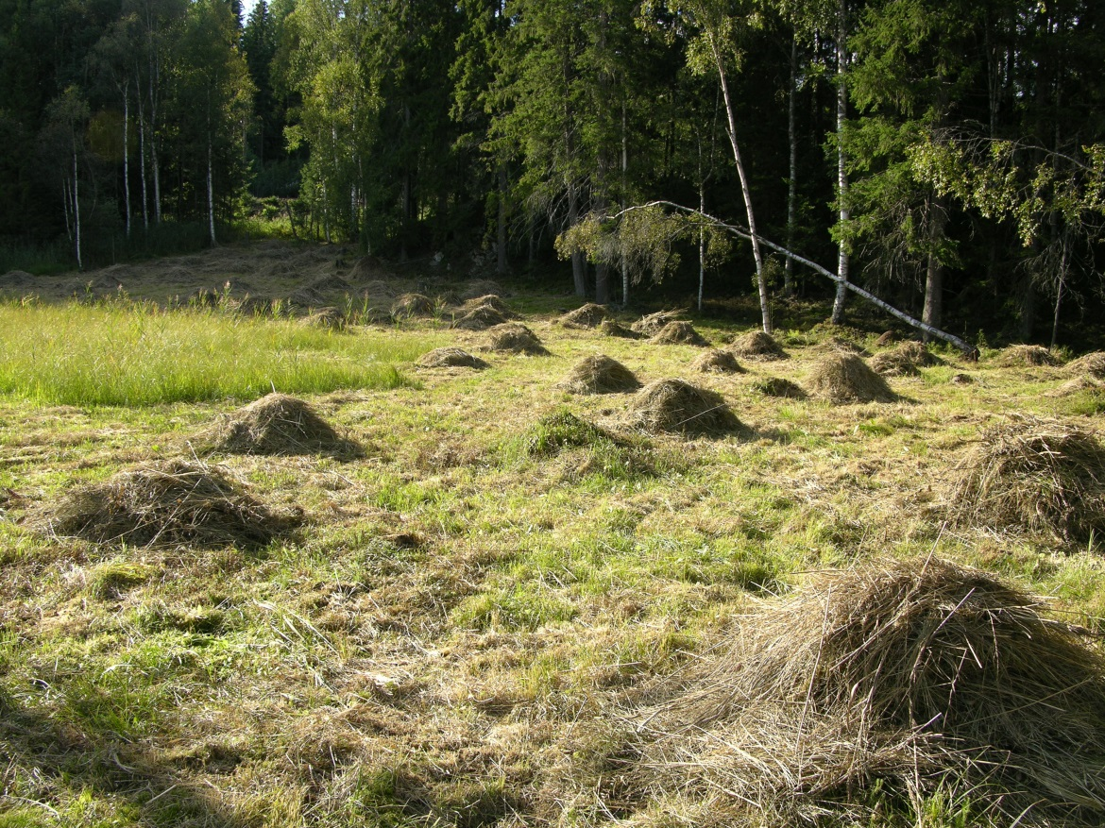
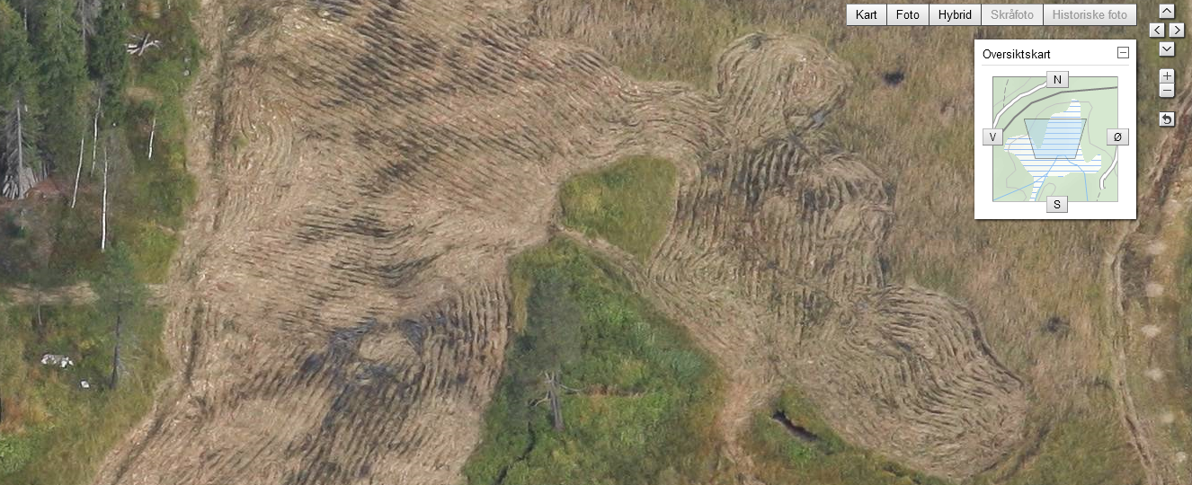
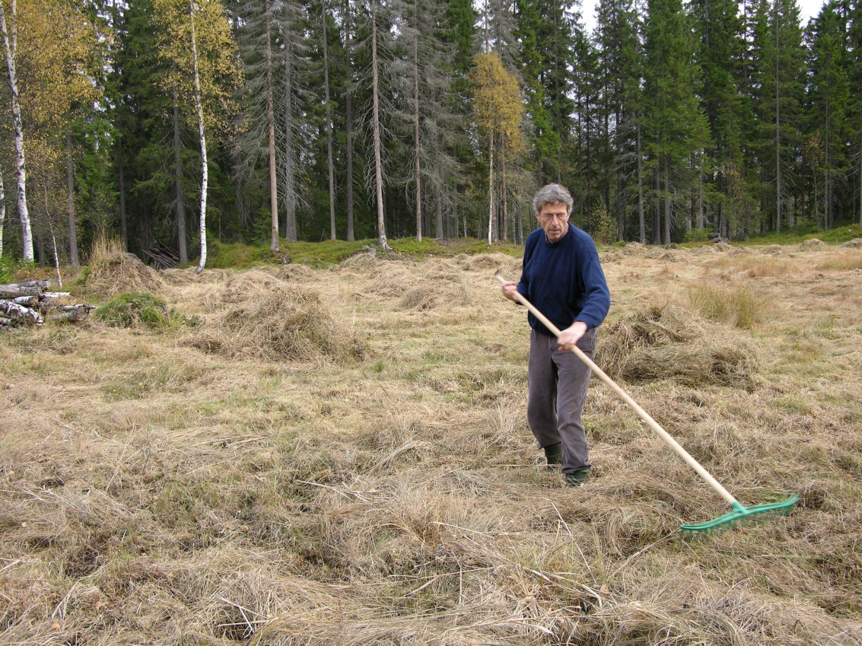
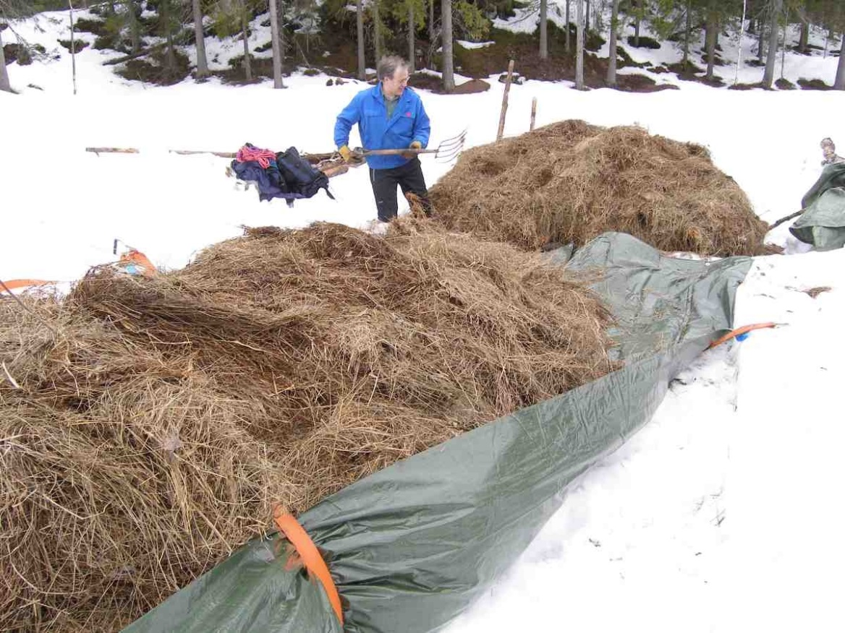
Management
  The vegetation at Slåttemyra is cut in late summer, mostly by use of a two-wheel tractor
  Different parts of the mire are cut at differerent intervals (annually, biannually, or more rarely)

Slide 9
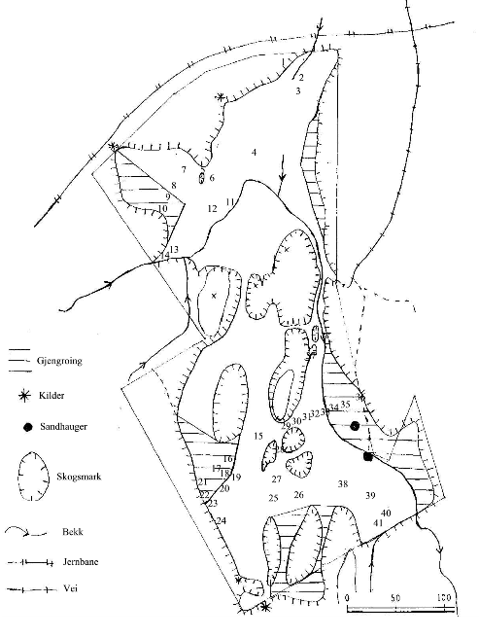
Monitoring of vegetation change
  Repeated recording in permanent vegetation plots is the optimal strategy for studying vegetation change
  In 1996, AM & TØO esta-blished six permanent plots
    2 for monitoring of vegetation
    4 for monitoring of orchid flowering
  In year 2000, three years after the onset of restoration, TØO established 41 plots, each 3x3 m, that included (parts of) the six 1996 plots

Slide 10
Sampling
  Selective sampling of
  41 plots, including:
    11 plots not subjected to management prior to year 2000
    .. of which two (40 and 41) were cleared (and subsequently cut) 2004–2005
    ... leaving 9 unmanaged controls
    30(+2) plots in managed areas
      ... of which four (6, 11, 15, 27) were subjected to burning of remains from tree clearance in 1997

Slide 11
Recording in the field
  In all 41 plots,
    vascular plant species composition has been recorded by TØO every year since 2000; and
    cover has been recorded on an 8-point 2-logarithmic scale (the Hult-Sernander-Du Rietz scale with the lowermost class expanded)
Class | Cover
1 | < 1/128
2 | 1/128–1/64
3 | 1/64–1/32
4 | 1/32–1/16
5 | 1/16–1/8
6 | 1/8–1/4
7 | 1/4–1/2
8 | < 1/2

Slide 12
Gradients in species composition identified a priori
  The plots span variation along major gradients in species composition and the environment
    from slightly paludified terrestrial sites bordering on the mire via mire margin to mire expanse
    on the mire expanse, from hummock/lawn to carpet
    from poor via intermediate to rich sites (the classical ’poor–rich’ gradient)

Slide 13
Gradients in species composition identified by ordination
  Basic data set
    156 species x 41 plots
    each plot represented by the average of 14 cover recordings, rounded up to the nearest integer cover value
  Parallell ordinations by
    GNMDS (with PD dissimilarities, using the step-across algorithm; at least 100 random starting configurations; accepting best-stress solution when obtained from two random starts)
    DCA (with standard options)
    Software: R, vegan package
  Ordination axes accepted (as valid gradients in species composition) if and only if confirmed by the other method (Kendall’s non-parametric correlation coefficient τ> 0.4)
  Two GNMDS axes were confirmed by DCA

Slide 14
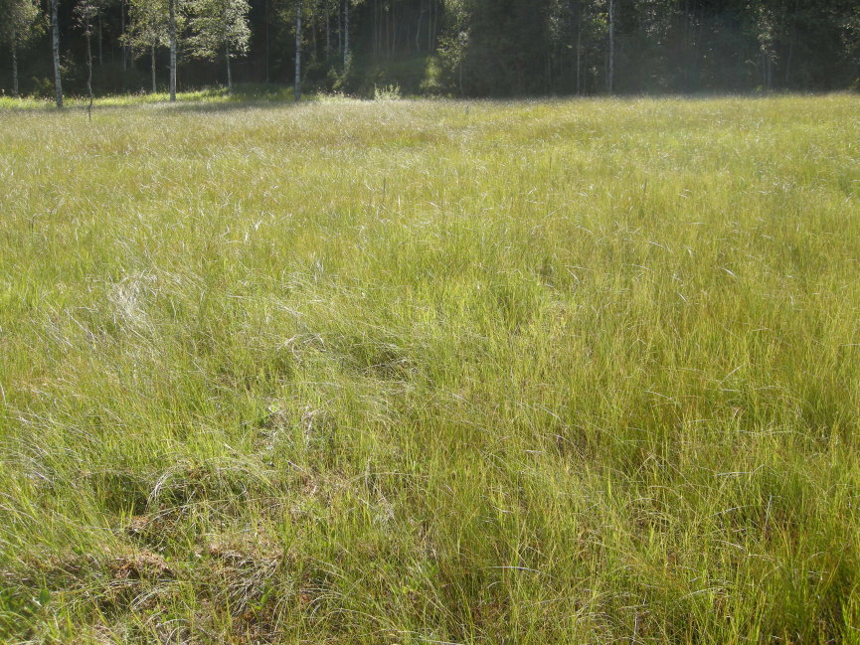
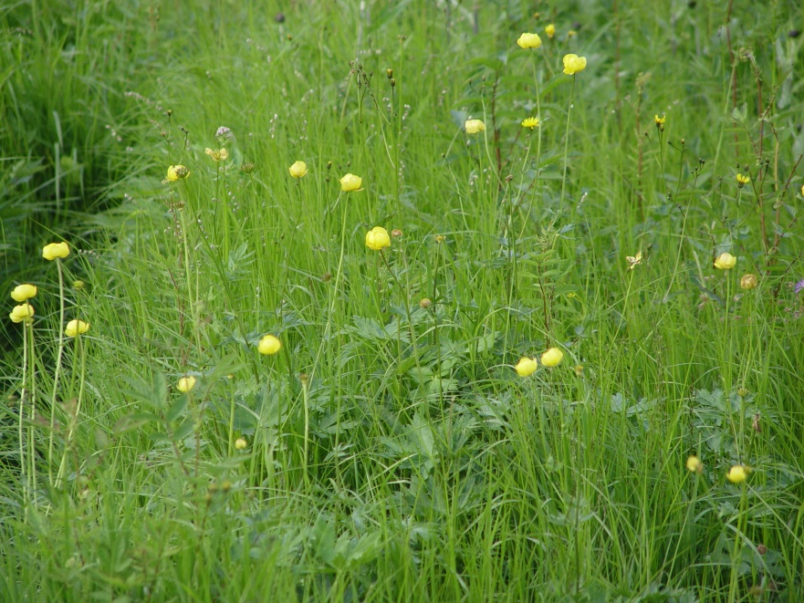
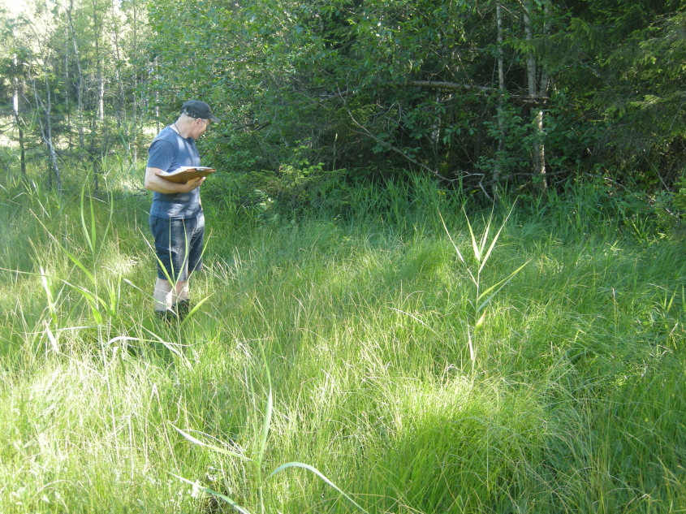
GNMDS ordination of basic data set

Slide 15
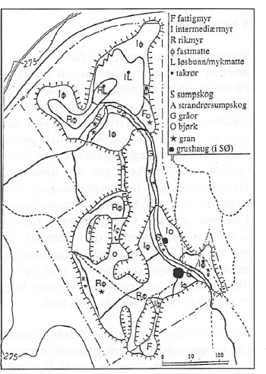
  The gradient structure described by Moen & Olsen (1997) was confirmed by multivariate analyses

Slide 16
Vegetation change during restoration succession
  Full data set
    156 species x 574 plot-by-time-combinations (41 plots x 14 time-points)
  Parallell ordinations by
    GNMDS (same specifications as in ordination of basic data set)
    DCA (with standard options)
  The two GNMDS axes were closely similar to axes obtained for the basic ordination
    Kendall’s non-parametric correlation coefficient τ between plot positions averaged over the 14 years > 0.7
  The interpretation of the ordination of the basic data set thus also applies to the ordination of vegetation change

Slide 17
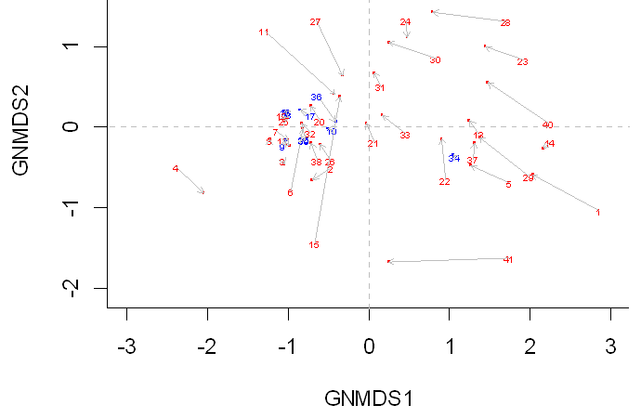
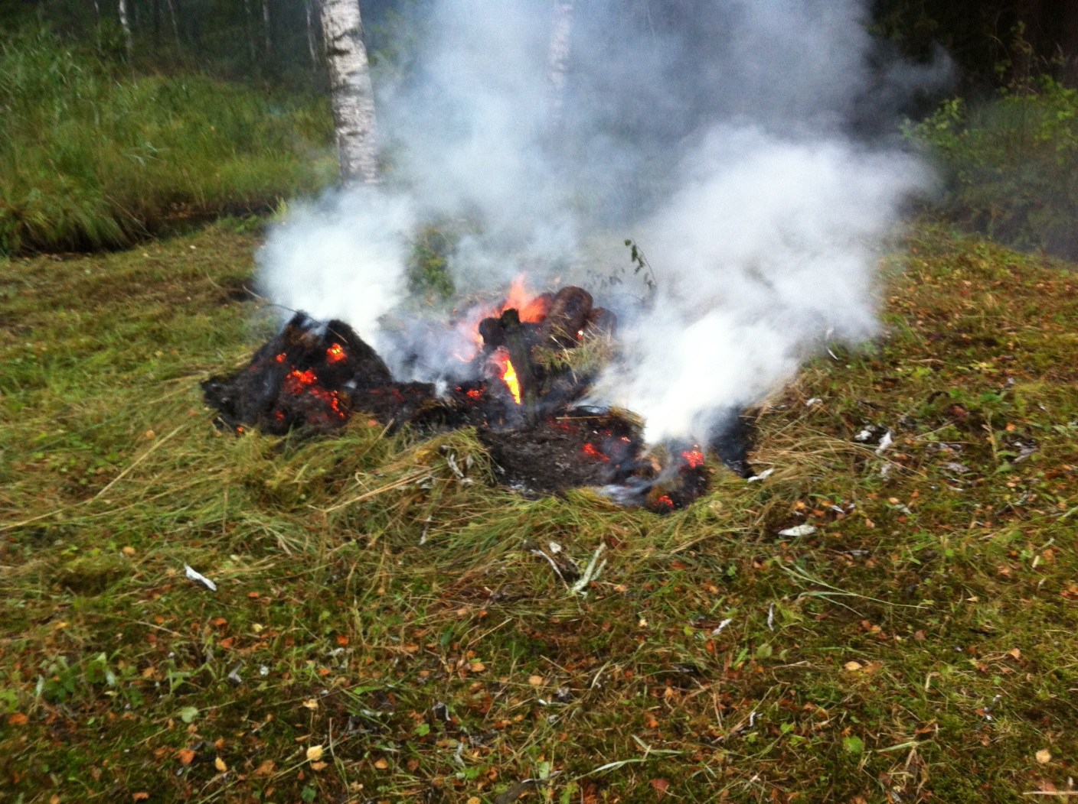
Vegetation change during restoration succession
Among unburnt, managed plots, vegetation chan-ge is largest for plots 40 and 41 which have been followed from the onset of restoration
Almost no change observed for unmanaged plots (blue numbers)
Managed plots move towards the centre of the ordination diagram, indicating that management brings about strong homogeni-sation of the species composition
Kendall’s τ between 13-yr displacement and average position along axis 1: τ = –0.4541, P = 0.0002
In particular, vegetation change is considerable for managed plots on mineral soil and close to the mire margin
The largest compositional shifts are found for the burnt plots
First recorded three years after burning, these plots were dominated by nitrophilous and pioneer species which were later replaced by mire species

Slide 18

Vegetation change during restoration succession
The ‘typical’ hay-making mire community is an intermediate-to-rich lawn

Slide 19

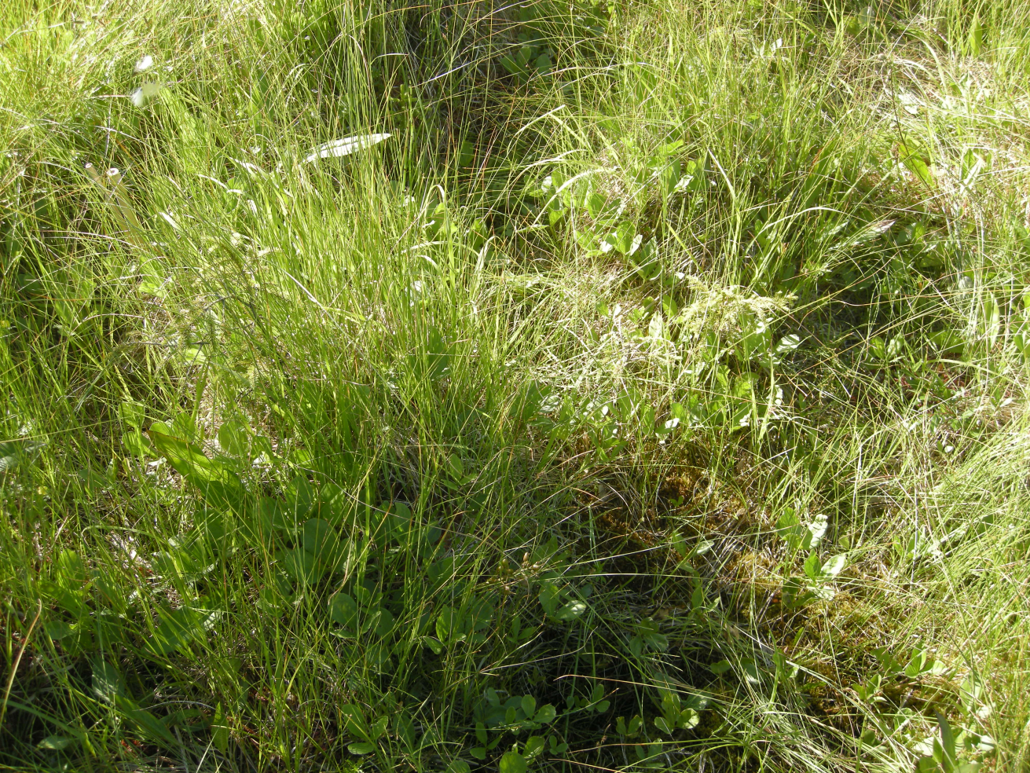
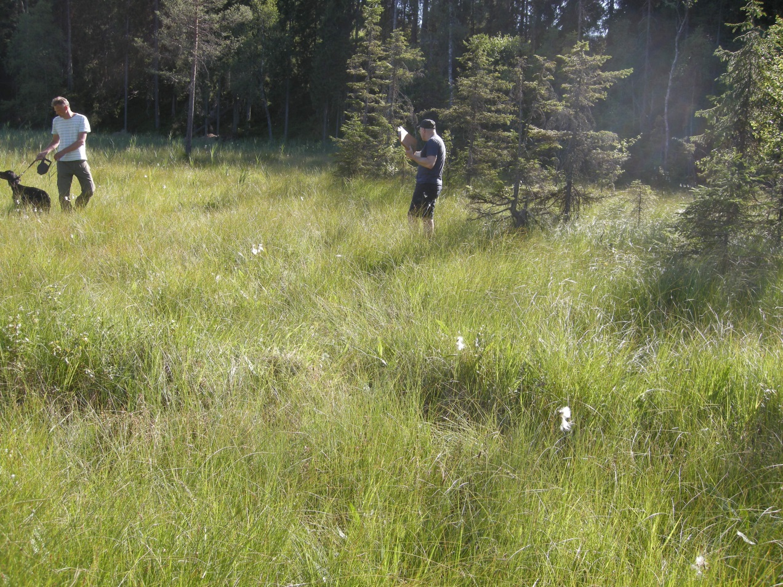
Hay-making from an ecological point of view
  Hay-making is a disturbance factor that
    levels out micro-topographic variation

Slide 20
Does hay-making affect species density?
  species density = number of species recorded in a plot
  hay-making plots (n = 32):
    2000: 20.63
    2013: 22.22
    Change: + 1.59 (Wilcoxon-Mann-Whitney test: P = 0.046)
  unmanaged plots (n = 9)
    2000: 19.56
    2013: 21.67
    Change: + 2.11 (WMW test: P = 0.191)
  Difference insignificant (WMW test, P = 0.7399)
  Hay-making (as has been carried out on Slåttemyra) has not affected vascular plant species density
  This accords with results of previous studies

Slide 21
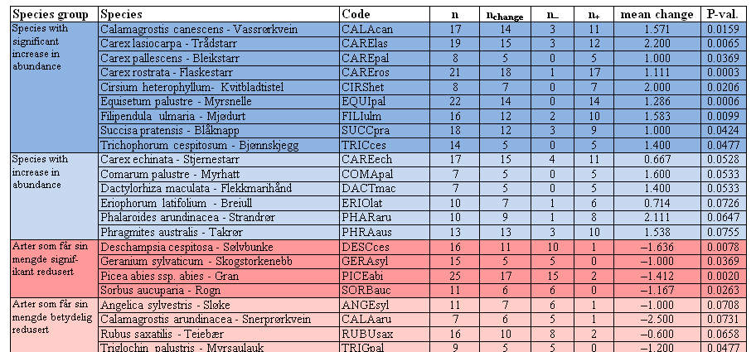
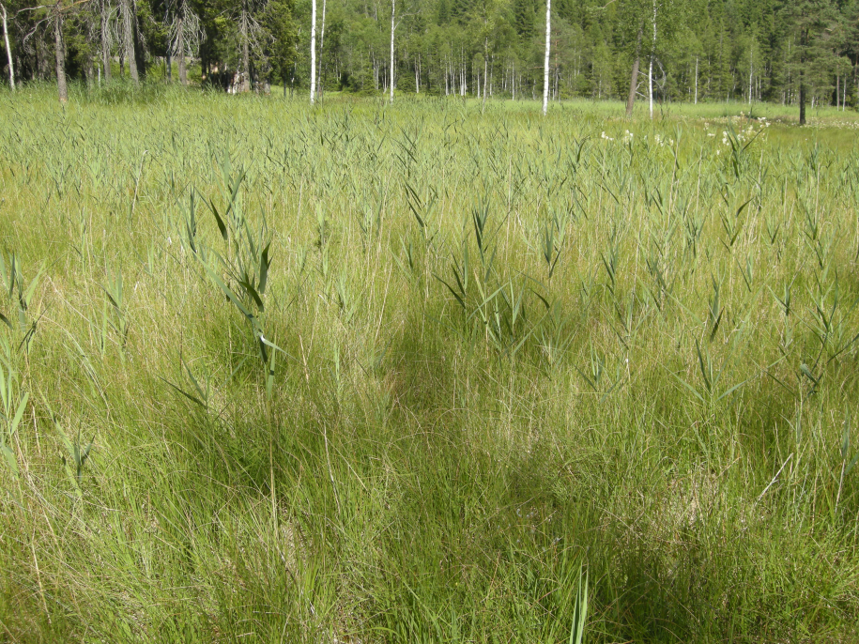
Which species respond to hay-making?

Slide 22
The outcome after 17 years of restora-tion of a south boreal hay-making fen
  An undrained hay-making fen landscape can been fully restored even if restoration starts fifty years after cessation of hay-making
  Restoration of hay-making fens require patience, physical (and psychical?) strength and ecological skills
  Directional vegetation change still takes place 17 years after the onset of restoration
  Permanent plots are important,
    for documentation of vegetation change during ecosystem restoration, and
    to provide new knowledge of ecosystem change
    to provide input for revision of management plans
  A challenge: controlling Phragmites australis

Slide 23
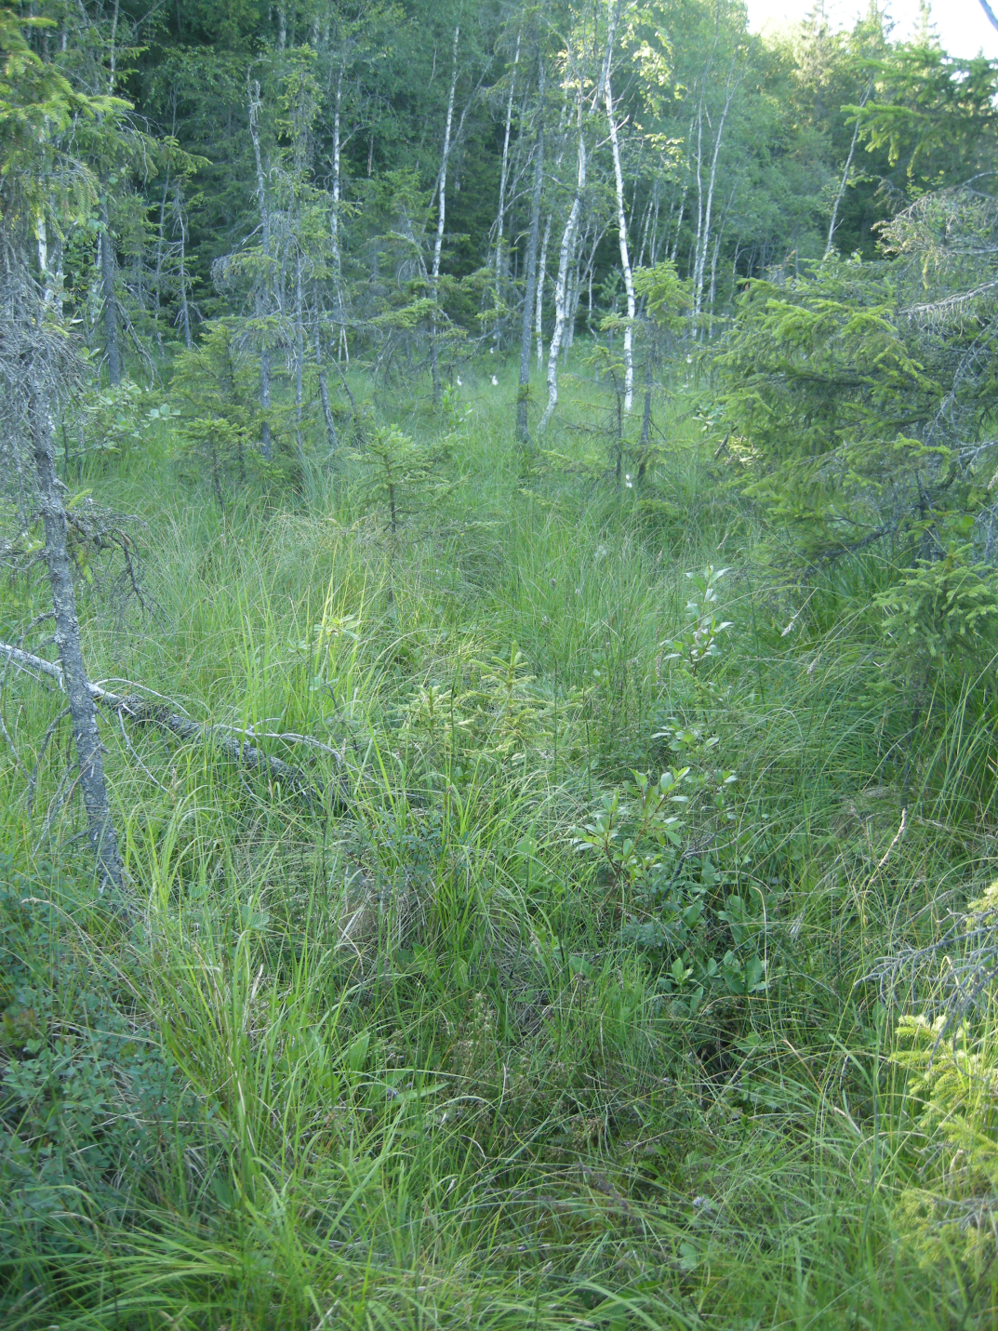
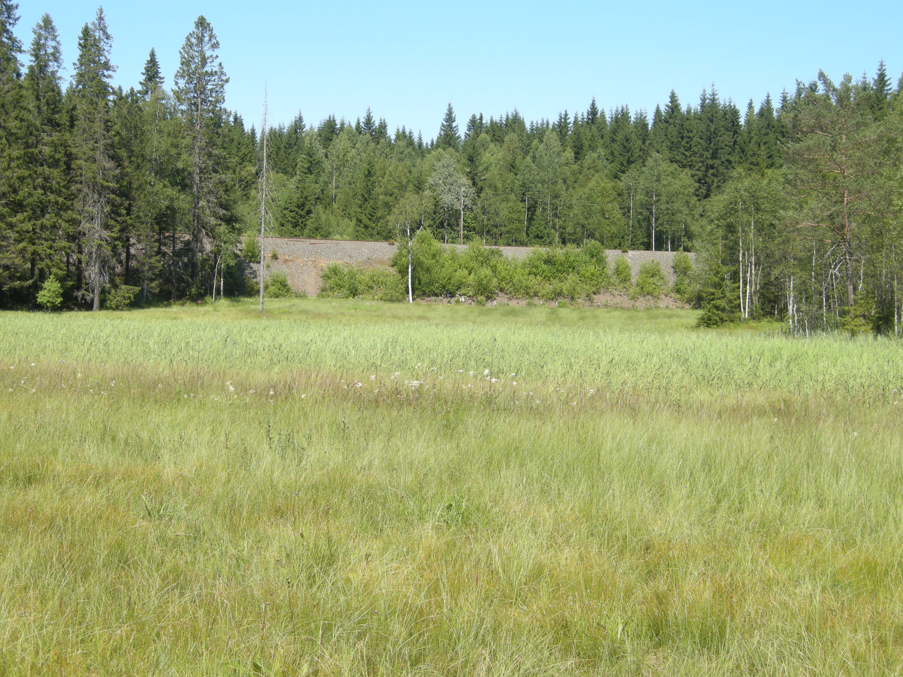
  We thank Asbjørn Moen for re-discovering Slåttemyra and for his efforts to protect and assist restoration of this, and other, unique cultural landscapes

